Slide 1
Logistic Regression
Sean Kang

Slide 2
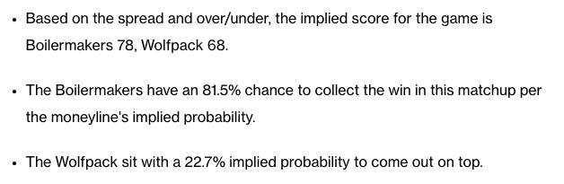
What is Logistic Regression
One of a type of classification algorithm (many other exists)
Analyzes the relationship between the dependent variable with one or more independent variable. Also used for prediction.
This measures the coefficients between the dependent variable with the one or more independent variable.
It is used to measure the probabilities of the classification result.
Notes:
https://www.foxsports.com/stories/college-basketball/purdue-vs-n-c-state-march-madness-final-four-prediction-odds-picks

Slide 3
Multiple types of Logistic Regression
Binomial (binary) Logistic Regression – analyzes the relationship with a dependent variable that has a binary outcome. It is a regression analysis when the outcome or dependent variable is binary – dichotomous (true/false, die/live, buyer pays/no-sale, pass/fail…).
Multinomial Logistic Regression – analyzes the relationship on an outcome or dependent variable which has three or more values (example, the type of product purchased, type of injury, type of animal recognized by image scanner). The outcome does not have a rank.
No: low, medium, high
Yes: mammal, amphibian, fish, bird, etc
Ordinal Logistic Regression – predicts the probability that an outcome or dependent variable generates into an ordinal value (severity of the cancer, level of customer satisfaction (low, medium, high), etc)

Slide 4
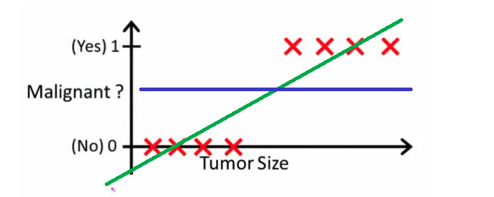
Why use Logistic Regression over Linear Regression?
In linear regression, the outcome or output is some scalar value such as MPG.
But logical regression, the output is a value such as True/False, Buy/Pass, Win/Lose, etc.

Slide 5
How does Logistic Regression work?
Similar General Steps
1.) Prepare the data
2.) Train the model
3.) Evaluate the model
4.) Use the model on predictions

Slide 6
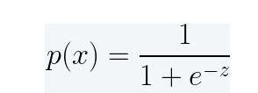
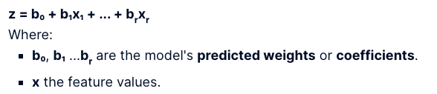
The Math behind Logistic Regression
In a binary classification case the formula for the regression function is:
Z is a linear function which looks like this:

Slide 7
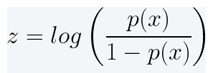
More Math
The z is also known as the log loss function
p(x) is the probability of success, 1-p(x) is the prob of failure

Slide 8
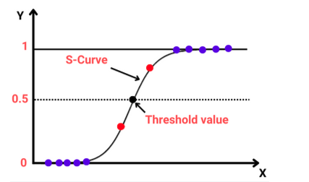
Aspects of the Logistic Regression
Binomial – the outcome is a value of 1 or 0.
However, the model will generate a probability value between 1 and 0, for Binomial situations.
Unlike linear regression model, the logistic regression uses a S-shape logistical function –Sigmoid function.
Threshold value is used

Slide 9
Assumptions
Responses are binary or multinomial
Independent variables have no collinearity
No extreme outliers
Linear relationship between input variables and log-odds of the response
Large sample size

Slide 10
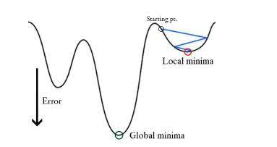
How to measure fitness
With a linear regression, MSE or RMSE is used.
If MSE is used for a logical regression, local minima is found, and the global minima is missed.

Slide 11
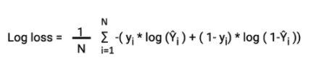
Loss function for Logistic Regression
Log loss is used for measuring the error in the model, derived from the maximum likelihood estimator (MLE)
This involves finding the best coefficients to fit the sigmoid curve.

Slide 12
How to do this with SciKit Learn
Demo
SciKit Learn has a LogisticRegression library
We should know that there are hyperparameters that are important
Solvers
C
Penalty

Slide 13
Hyperparameters
Solver -the algorithm used for optimize the problem
Default used in SciKit is lbfgs
Lbfgs has decent performance and works well in most cases.
Sag works best for large datasets
Saga works better for multinomial
Liblinear works when you have a many features and dimensions.
Penalty - works to avoid overfitting, default is l2.
The various choices work with specific solvers (l1, l2, elasticnet, etc)
C – regularization strength – default is 1.
Positive float value
Low value -> stronger regularization, Higher value -> give more priority on training data

